Slide 1
End-User Experience Changes

Slide 2
Welcome To Check Point Harmony Email & Collaboration Security!
To help you roll-out Check Point Harmony Email & Collaboration Security to your end users, we have a series of templates to help you message and prepare your end-users.
Many of these changes will depend on the settings you as an administrator set in the Check Point Harmony Email & Collaboration Security console; therefore, make sure to only send out the relevant content to your end-users.

Slide 3
Welcome Template (1 of 3)
[ COMPANY NAME ] Employees,
Our security team is advancing in the global cyber security battle. Some of the major challenges include malware and phishing attacks entering our systems via the cloud applications we use along with sensitive information leaked out.
I'd like to announce our integration with the Check Point Harmony Email & Collaboration Security Cloud Security platform. Check Point Harmony Email & Collaboration Security protects our cloud from the latest security threats by combining the power of best security tools in the market. Whether it's fake login form that attempt to steal your credentials, ransomware that locks attempts to lock down our devices, or impersonated emails pretending to be from someone we are familiar with - Check Point Harmony Email & Collaboration Security protects you.
More info about Check Point Harmony Email & Collaboration Security can be found at: https://www.checkpoint.com/harmony/email-security/email-office/
In preparation to protecting our entire organization, Check Point Harmony Email & Collaboration Security has provided us with a few safety tips to keep in mind:
Rather than sending files to non-employees as email attachments, it's always preferred to share files over [ FILE-SHARING-SAAS ], where access permissions are clearly defined, and can be revoked as needed.
Warning messages might come up in your emails in the form of a subject change or even within the email body. For example, when someone new sends you an email, you will be asked to confirm whether you trust this email or not.
Some emails detected as phishing or malicious before arriving in your inbox - and therefore quarantined, you may receive a notification with the option to retrieve the original email. Please use caution when attempting to retrieve quarantined data.
Let me know if you have any questions or concerns about the new security change.
You can reach me at: Email: [ ADMIN EMAIL ] Phone: [ ADMIN PHONE ] Thanks, [ ADMIN NAME ] System Administrator [ COMPANY NAME ]

Slide 4
Welcome Template (2 of 3)
[ COMPANY NAME ] Employees,
We are deploying a new security application for our [Office 365, Google] email.
You may notice a few changes to your inbox.
The subject of the email might indicate if it is suspicious with an [Alert/Phishing] message. Treat these messages carefully.
You may see a message at the top of the email which asks if you trust this user. Take a moment to confirm the source and the content and select "yes" or "no" as appropriate.
If you receive an email with a suspicious attachment, it may be quarantined. In some cases, you will have an option to retrieve the document. If so, proceed with caution.
[insert other security policies here] Examples:
When sharing a file, it is always better to use [file-sharing app: Box/OneDrive/etc.] than to send via email.]
When any email requests money, personal data, or other confidential information, contact the sender via phone or other method to confirm the message.]
Never use the same password on more than one site.]
As always, we take your email security concerns seriously. Refer any questions or doubts to us at:
Email: [ ADMIN EMAIL ]Phone: [ ADMIN PHONE ]Thanks,[ ADMIN NAME ]System Administrator[ COMPANY NAME ]

Slide 5
Welcome Template (3 of 3)
Our security team is advancing in the global cyber security battle. Some of the major challenges include phishing and malware attacks entering our systems via Office 365. Therefore, I'd like to announce our integration with the Check Point Harmony Email & Collaboration Security Cloud Security platform. More info about Check Point Harmony Email & Collaboration Security can be found at: https://www.checkpoint.com/harmony/email-security/email-office/
In preparation to protecting our entire organization, please note the following changes of behavior for email:
Emails detected as phishing or malicious before arriving in your inbox will be quarantined. If you did not receive an email that you are expecting, please reach out to [OUR IT TEAM] with the sender's information to see if the email was quarantined.
Emails detected as phishing or malicious before arriving in your inbox will be quarantined. You will be notified of this, and given the option to request the email be restored to you by [OUR IT TEAM].
You may receive warnings at the top of the email bodies that indicate that an email contains qualities of phishing
These 3 templates can be used in conjunction with the screenshots and further messaging below.

Slide 6
Warning Banners
With Check Point Harmony Email & Collaboration Security, we should be seeing very few legitimate emails blocked because one of the new things you will see are detailed Warning Banners above the body of an email that Check Point Harmony Email & Collaboration Security suspects to be phishing.
The banners also allow you to give feedback to Check Point Harmony Email & Collaboration Security on whether you think the email is legitimate.
The following screenshots will show examples of these informative warning banners.

Slide 7
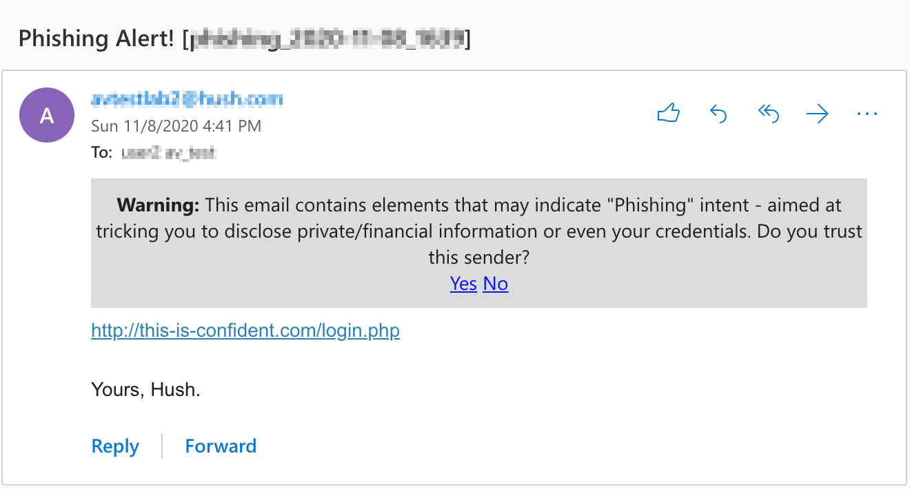
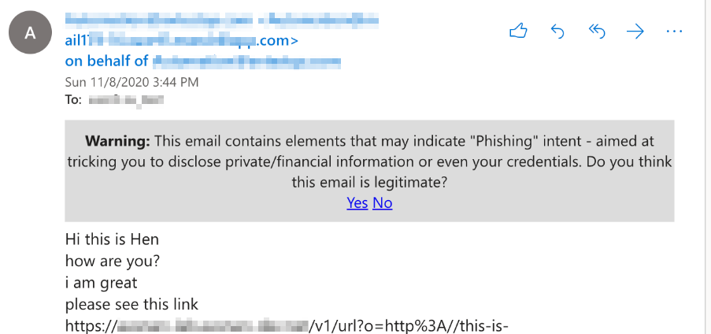
Warning Banners

Slide 8
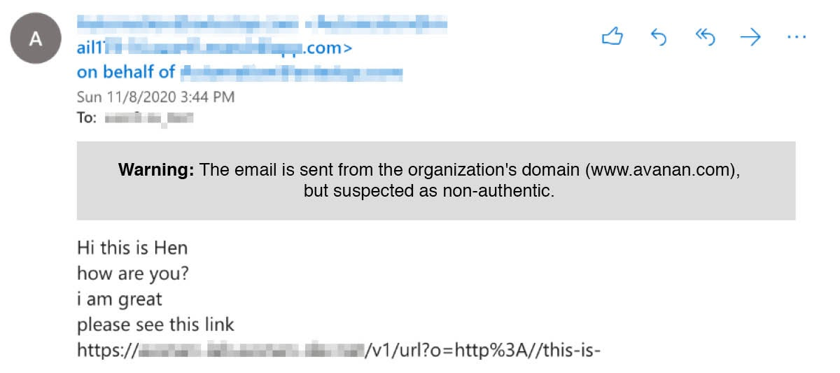
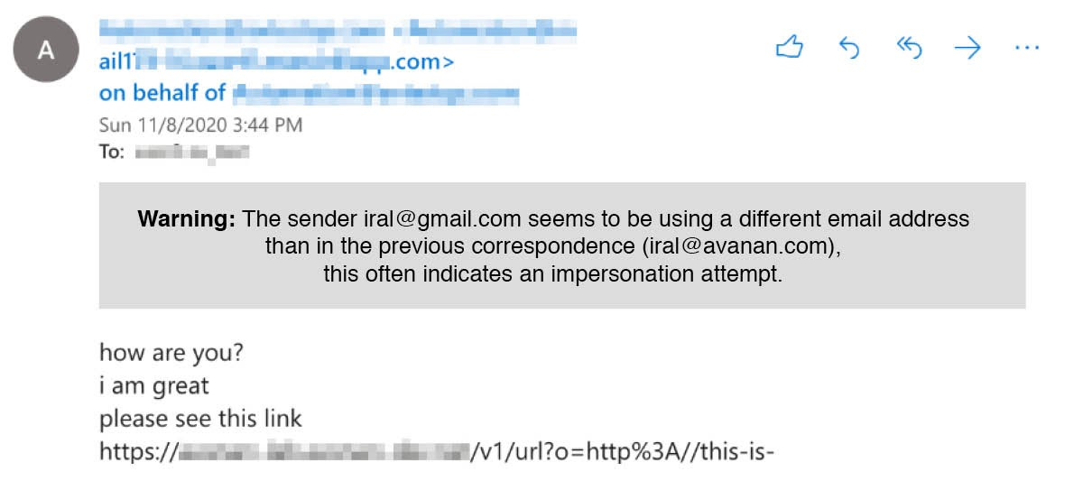
Warning Banners

Slide 9
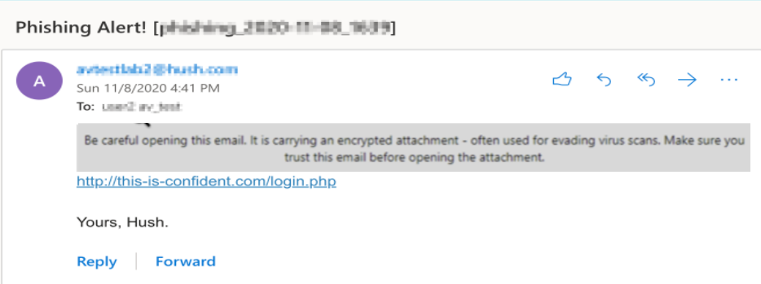
Warning Banners

Slide 10
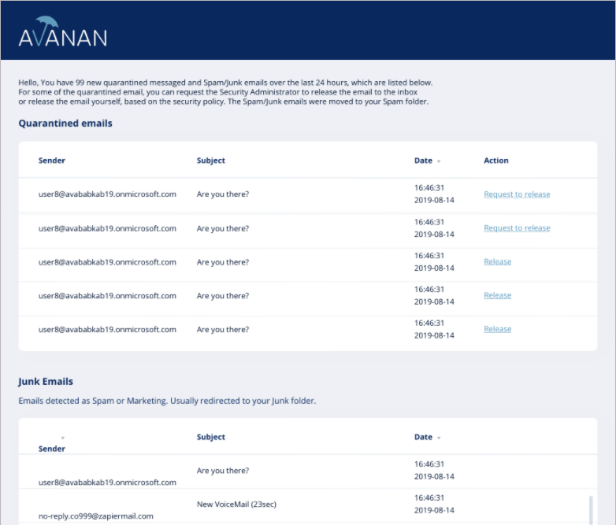
Daily Email Security Summary
You will now receive a summary of all the emails that Check Point Harmony Email & Collaboration Security blocks
From this summary email, you will get a glimpse of all the security threats that bombard your mailbox every day.
If you disagree with Check Point Harmony Email & Collaboration Security, with a simple click of a button found in the summary email, you will be able to Release any emails that Check Point Harmony Email & Collaboration Security found Suspicious.
As well as Request To Release any emails that Check Point Harmony Email & Collaboration Security is confident is Phishing
The email will then be submitted to the admins for review

Slide 11
Individual Quarantine Alerts
In addition to a summary of alerts, your administrator can configure individual alerts to go out whenever an email is blocked by Check Point Harmony Email & Collaboration Security. The individual alert email will also contain a link to request to release the quarantined email.
The frequency of these alerts can be adjusted by your administrator and you can also request to restore these emails from the alert email.
The next few screenshots will show examples of these individual quarantine alerts.

Slide 12
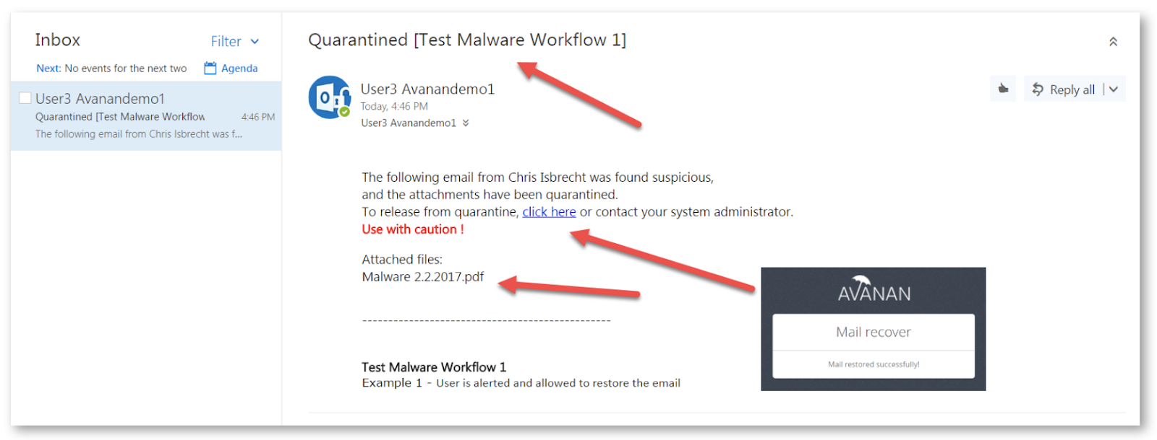
What a Quarantine Notification Looks like

Slide 13
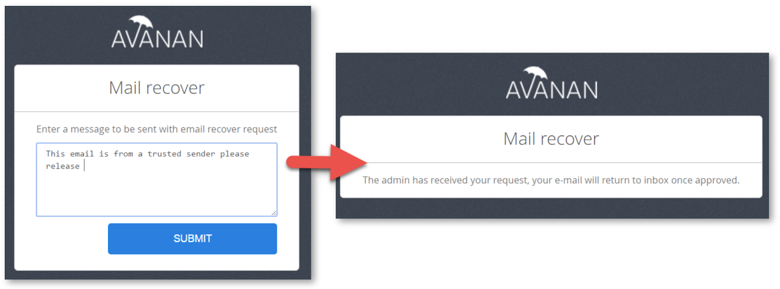
What a Quarantine Notification Looks like
If the request is approved by the administrator the original message will be delivered unaltered to the user.

Slide 14
Click-Time Protection
From time to time you will see links in your emails that are not in a format you expect
Check Point Harmony Email & Collaboration Security will change all suspicious links in your emails to a safe version. The Check Point Harmony Email & Collaboration Security secured links will have the format:
https://url.Check Point Harmony Email & Collaboration Security.click/v2/___<original malicious link> ___<encrypted gibberish>
Here’s an example of such a link:
https://url.Check Point Harmony Email & Collaboration Security.click/v2/___http://www.malware.com___YXAzOnByb2QtMy1jb24tbGF iMzU6YTpvOjYyNTM2MTk3ZWYwMTc3MjJhZmExMGY0MTMwNDgzMzNhOnYyOjI3MTY6N2FiOTAwYjgwNDMzMzFkYWRjZWQyYTE5MzRmMmViMzVkMTAwMGYzMjBlNTZmMDg0MTliNTIzOTFiZmZkZDllYg

Slide 15
Click-Time Protection
If you cannot determine that an email with a custom Check Point Harmony Email & Collaboration Security secure link is malicious, you can click the link to have Check Point Harmony Email & Collaboration Security perform a real-time scan of the target website.
If the link is benign, you will be taken to the website like normal; however, if the link is found to be malicious, you will see the page below open up instead.

Slide 16
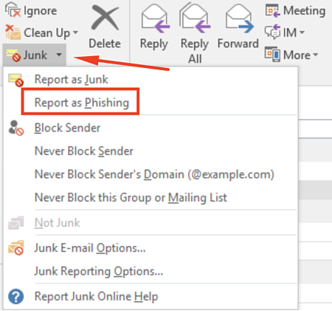
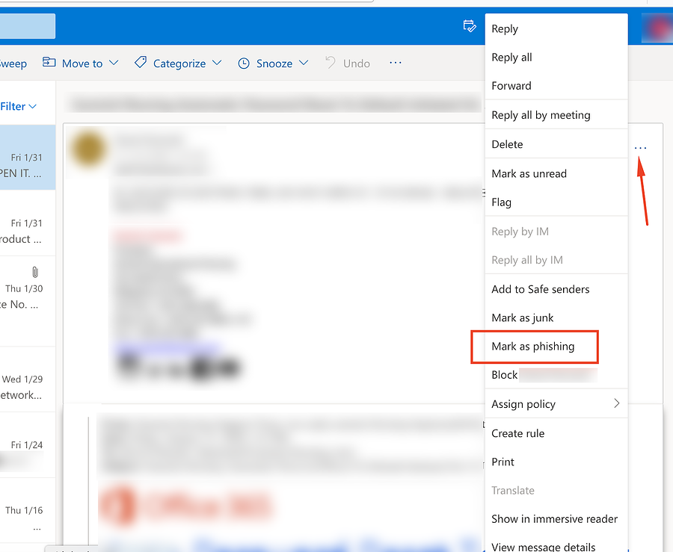
User Reported Phishing
One of the ways you can improve Check Point Harmony Email & Collaboration Security and your company’s security posture is by diligently reporting potentially missed attack emails as Phishing. Check Point Harmony Email & Collaboration Security and your administrators will then investigate the issue and if the missed email is proven to be malicious, we will promptly adjust our configurations to make sure those attacks are dealt with automatically next time.

Slide 17
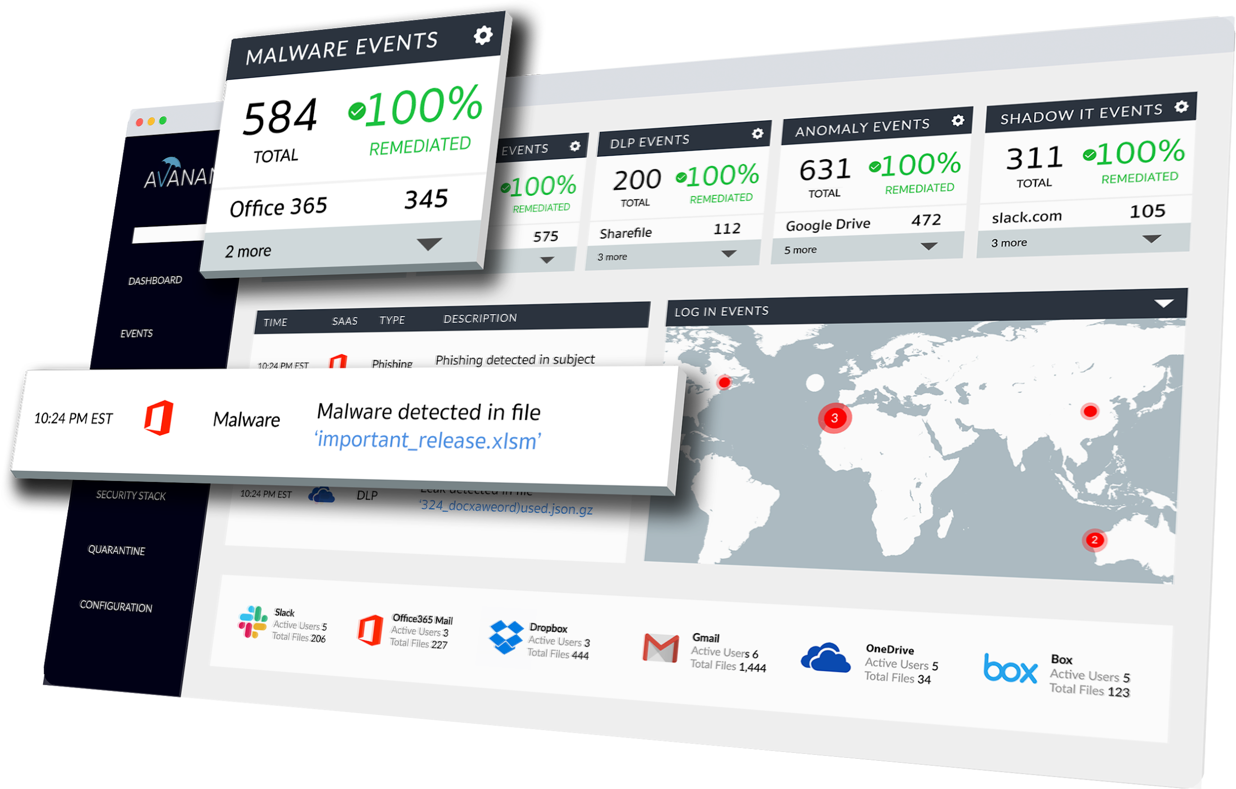
Thank You

